Slide 1
PROGRAMMING FOR PROBLEM SOLVING
SEMESTER:
PREPARED BY:

Slide 2
eXPRESSIONS
INTRODUCTION
An expression is a collection of operators and operands that represents a specific value.
It may consist of one or more operand or zero or more operators to produce a value.
For example: A=B+C*D
In above example we have two operator like “+” & “*” and three operand like B,C and D and one variable to store the value of expression.

Slide 3
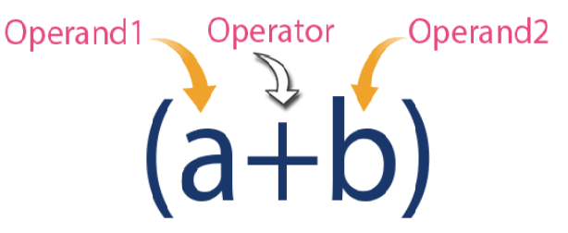
FOR eXAMPLE

Slide 4
TYPES OF EXPRESSIONS
There are three types of expression in C Programming
Infix Expression i.e:(a+b)
Postfix Expression i.e:(ab+)
Prefix Expression i.e:(+ab)

Slide 5
EVALUATION OF EXPRESSION
In c language expression evaluation is mainly depends on priority and associativity. An expression is a sequence of operands and operators that reduces to a single value.
Every expression results in some value of a certain type that can be assigned to a variable.

Slide 6
Examples of precedence
Operator | Priority | Associativity
{}, (), [] | 1 | Left to right
++, --, ! | 2 | Right to left
*, /, % | 3 | Left to right
+, - | 4 | Left to right
<, <=, >, >=, ==, != | 5 | Left to right
&& | 6 | Left to right
|| | 7 | Left to right
?: | 8 | Right to left
=, +=, -=, *=, /=, %= | 9 | Right to left
If we have equation 10-3%8+6/4
Step 1: 10-3%8+6/4
Then according to the precedence we have to do operation of (%) first so (3%8) becomes 3. So we have 10-3+6/4.
Step 2: 10-3+6/4
Now next we have a turn of (/) operator according to the precedence.
Step 3: 10-3+1
Now Next (-) will come according to the precedence.
Step 4:7+1
And at last we will have an answer 8

Slide 7
Type Conversion in C
A type cast is basically a conversion from one type to another.
There are two types of type conversion:
1) Implicit Type Conversion 2) Explicit Type Conversion

Slide 8
Implicit Type Conversion
Implicit type casting means
conversion of data types without losing its original meaning.
This type of typecasting is essential when you want to change data types without changing the significance of the values stored inside the variable.
#include <stdio.h>
main()
{
int number = 1;
char character = 'J'; /*ASCII value is 106 */
int sum;
sum = number + character;
printf("Value of sum : %d\n", sum ); }

Slide 9
Implicit Type Conversion
Note:
We cannot perform implicit type casting on the data types which are not compatible with each other

Slide 10
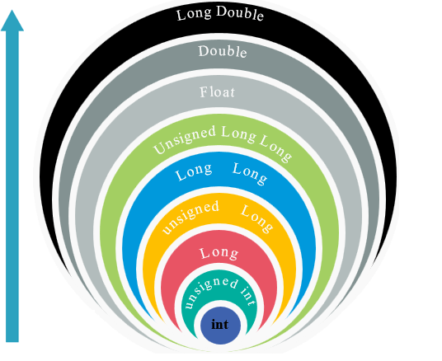
Arithmetic Conversion Hierarchy

Slide 11
Important Points about Implicite Conversions
Implicit type of type conversion is also called as standard type conversion. We do not require any keyword or special statements in implicit type casting.
Converting from smaller data type into larger data type is also called as type promotion.
The implicit type conversion always happens with the compatible data types.

Slide 12
Explicit type Conversion
Some scenarios of program in which we may have to force type conversion Explicitly that is called Explicit type Conversion .
Suppose we have a variable div that stores the division of two operands which are declared as an int data type.
Syntax:-
(type-name) expression
Example:-
int result, var1=10, var2=3;
result=var1/var2;

Slide 13
Explicit type Conversion
#include<stdio.h>
int main()
{
float a = 1.2; //int b = a;
//Compiler will throw an error for this
int b = (int)a + 1;
printf("Value of a is %f\n", a);
printf("Value of b is %d\n",b);
return 0; }

Slide 14
Operator Precedence
Operator precedence determines which operator is performed first in an expression with more than one operators with different precedence.
10 + 20 * 30 is calculated as 10 + (20 * 30) and not as (10 + 20) * 30

Slide 15
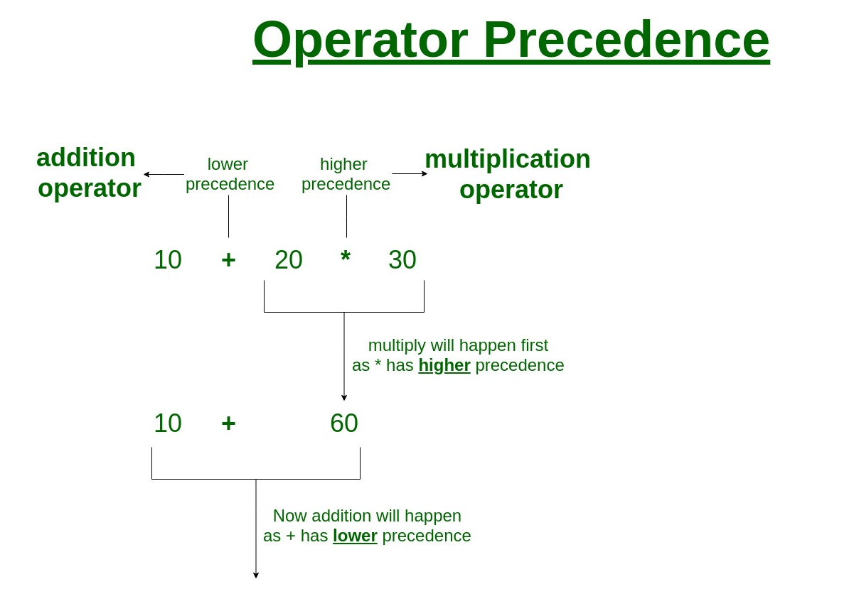
Operator Precedence

Slide 16
Operators Associativity
Operators Associativity is used when two operators of same precedence appear in an expression. Associativity can be either Left to Right or Right to Left.

Slide 17
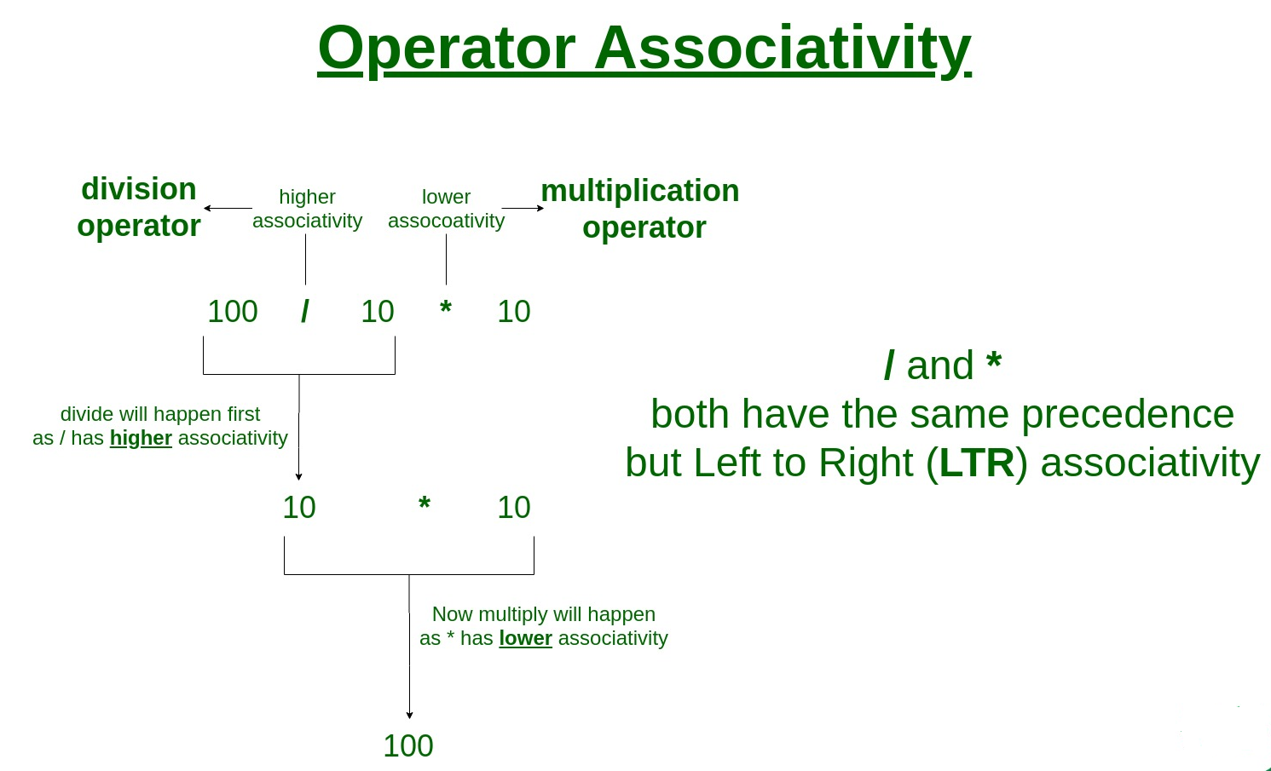
Operators AssociativeTy

Slide 18
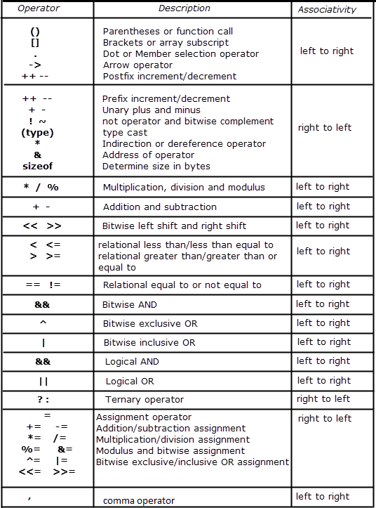
Operators AssociativeTy

Slide 19
I/o Functions
scanf() and printf() Functions.
The definition of these functions are available in stdio.h header file.
printf() function is used to take output from screen. And scanf() function is used to give input to the screen.
For example: printf(“Wel come to Silver Oak University”);
It will display the content which we had written in printf function.
And scanf(“%d”,&a); will take value of ‘a’ variable from user.

Slide 20
I/o Functions
getchar() and putchar() Functions.
getchar() :It reads the character from the terminal and returns as an interger.
We can use getchar function in loop if we want to read more than one character from user.
putchar() : The function displays the character passed to it on the screen and returns the same character.
If we want to display more than one character then we can use putchar() function in a loop.

Slide 21
I/o Functions
gets() and puts() Functions.
gets() : it reads a line from stdin(standard input) into the buffer pointed by str pointer,untill either terminated by new line or EOF.
puts() : It writes a string str and a trailing new line to stdout(standard output).
str : it is a pointer to an array of character where the c string is stored.
Example: gets(str);
Void main() puts(str);
{ getch();
char str[100]; }
printf(“enter string”);

